Slide 1
M1

Slide 2
15 Improvement In Food Resources

Slide 3
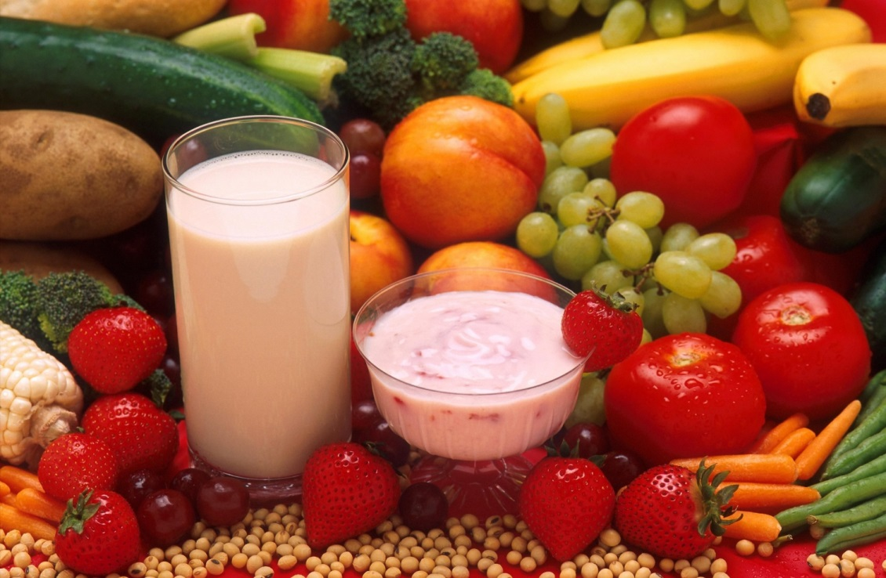
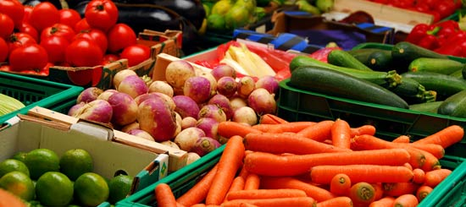
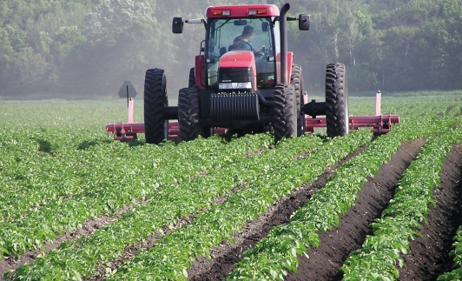
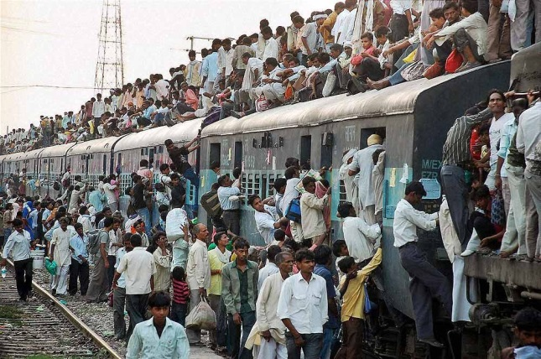
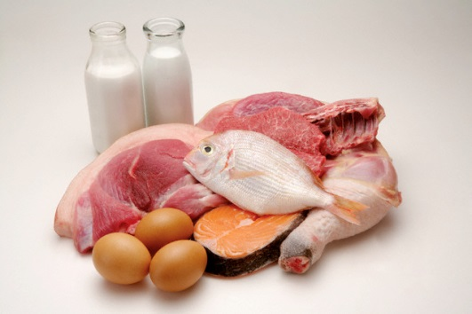
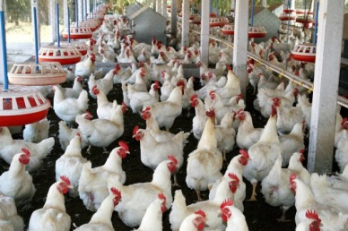
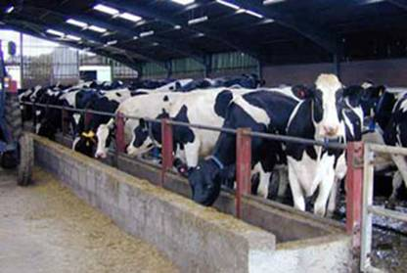
All living organisms need food.
Food supplies proteins, carbohydrates, fats, vitamins and minerals.
Both plants and animals are major sources of food.
From where do we get this food?
We obtain most of this food from agriculture and animal husbandry.
Breeding of animals for profit
India is a very populous country.
Our population is more than one billion and it is still growing.
Therefore, it is necessary to increase our production for both crops and livestock.
Animals

Slide 4
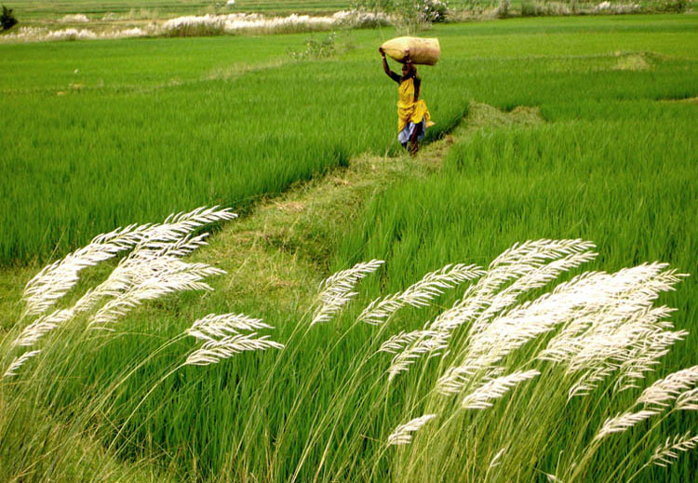
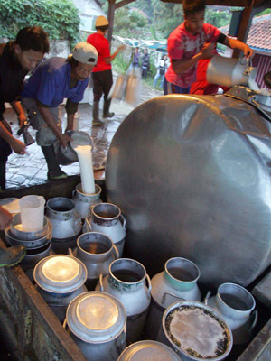
Efforts to meet food demand by increasing food production have led to some success so far.
We have had the green revolution, which contributed to increased food-grain production.
We have also had the white revolution, which has led to better and more efficient use as well as availability of milk.
a large increase in crop production in developing countries achieved by the use of artificial fertilizers, pesticides, and high-yield crop varieties.
However, these revolutions meant that our natural resources are getting used more intensively.

Slide 5
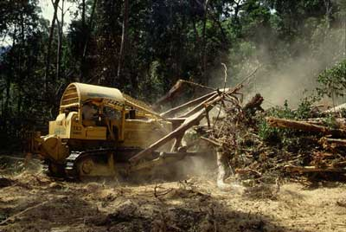
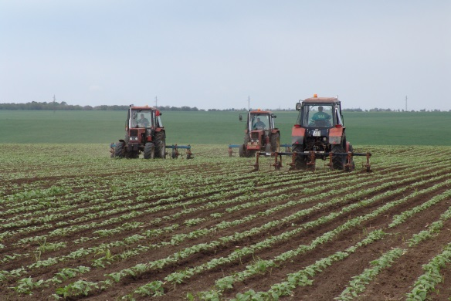
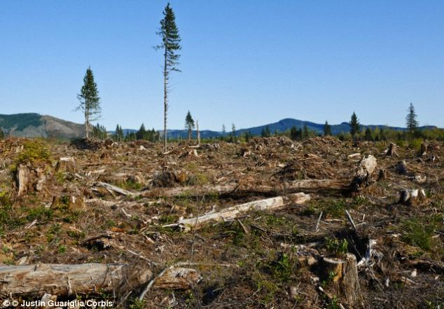
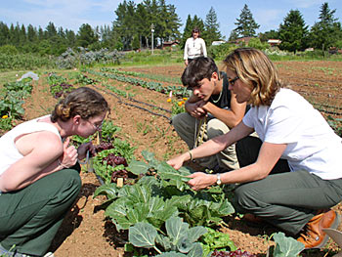
As a result, there are more chances of causing damage to our natural resources to the point of destroying their balance completely.
Therefore, it is important that we should increase food production without degrading our environment and disturbing the balance.
And hence there is a need for sustainable practices in agriculture and animal husbandry.
Which can be maintained at a certain level

Slide 6
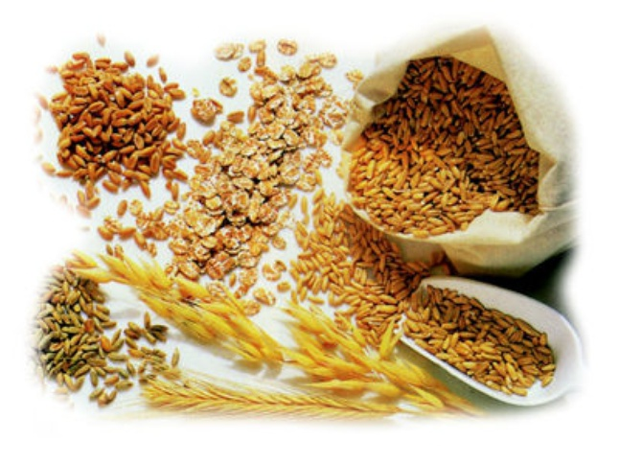
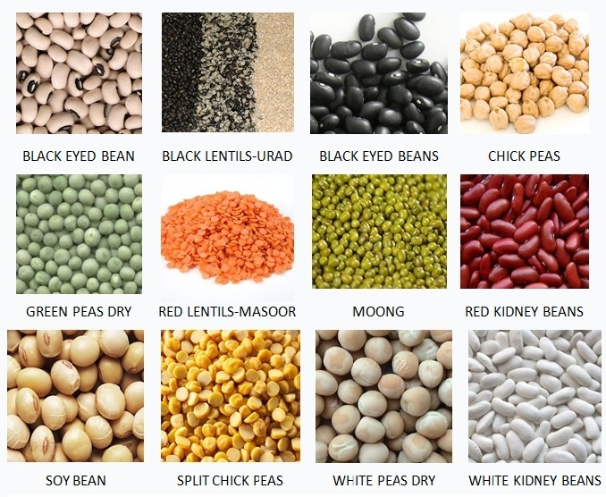
Improvement in Crop Yields :
Cereals such as wheat, rice, maize, millets and sorghum provide us carbohydrate for energy requirement.
Jowar
Small grain cereals eg. Bajara, ragi.
Pulses like gram (chana), pea (matar), black gram (urad), green gram (moong) Pigeon pea (arhar), lentil (masoor), provide us with protein.

Slide 7
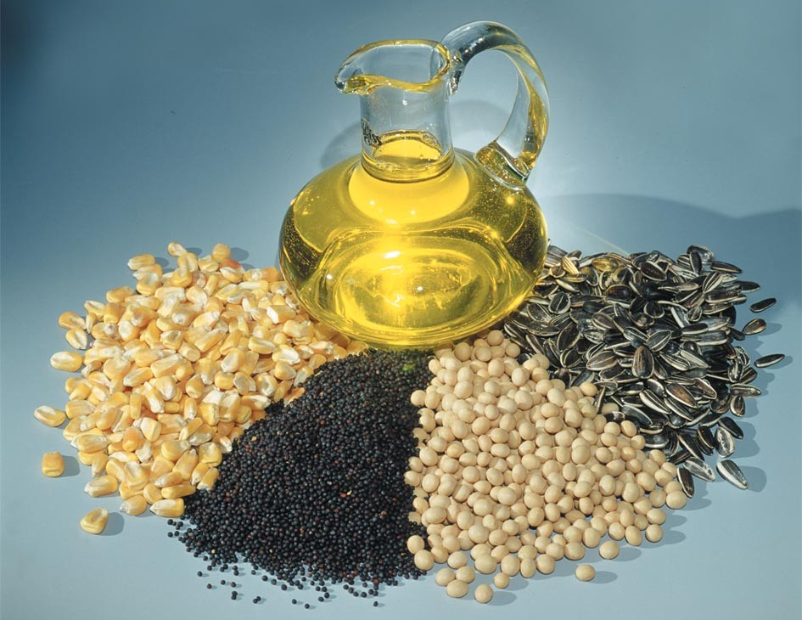
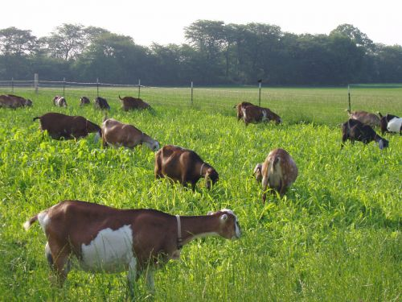
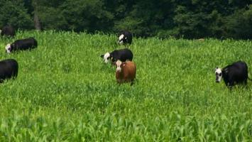
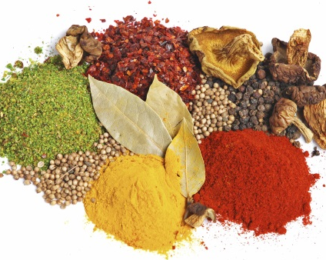
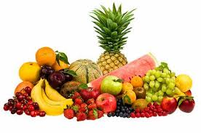
Improvement in Crop Yields :
And oilseeds including soyabean, ground nut, sesame, castor, mustard, linseed, and sunflower provide us with necessary fats.
Vegetables, spices and fruits provide a range of vitamins and minerals in addition to small amount of proteins, carbohydrates and fats.
In addition to these food crops, fodder crops like berseem, oats or sudan grass are raised as food for the livestock.

Slide 8
Different crops require different climatic conditions, temperature and photoperiods for their growth and completion of their life cycle.
duration of sunlight
Depending on this crops are classified into two types:

Slide 9
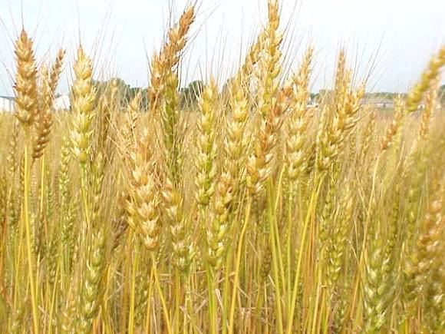
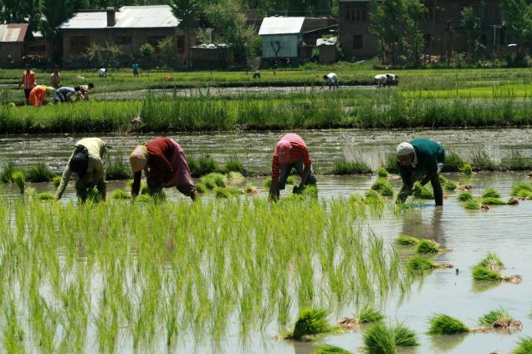
Crops
Kharif crops
Rabi crops
Crops grown in rainy season from the month of June to October.
Crops grown in winter season from the month of November to April.
E.g. Paddy, soyabean, pigeon pea, maize, cotton, green gram and black gram.
E.g. Wheat, gram, peas, mustard, linseed.
Rice

